Slide 1

UP SCHOOL & BITEXEN
WOMEN IN DATATHON
Merhaba!
Dilara Çankaya
Eda Çelikeloğlu
Gizem Öge

Slide 2




Cinsiyet Eşitsizliği
EĞİTİM
İŞ GÜCÜ KATILIMI
SAĞLIK
TOPLUMSAL CİNSİYET ROLLERİ
POLİTİKA
Notes:
KAYNAKÇA
1- Figueroa, C. A., Linhart, C. L., Beckley, W., & et al. (2018). Maternal mortality in Sierra Leone: From civil war to Ebola and the Sustainable Development Goals. International Journal of Public Health, 63(4), 431–432. The term "glass ceiling" describes the unseen barriers that women face when trying to ascend to top positions in the professional world.
2- Hornset, N., & de Soysa, I. (2022). Does Empowering Women in Politics Boost Human Development? An Empirical Analysis, 1960–2018. Journal of Human Development and Capabilities, 23(2), 291–318. The term "glass ceiling" describes the unseen barriers that women face when trying to ascend to top positions in the professional world.
3- UNFPA. (2023, May 8). UNFPA celebrates midwives for their roles in saving lives [Press release]. Retrieved from The term "glass ceiling" describes the unseen barriers that women face when trying to ascend to top positions in the professional world.
4- https://visitedplaces.com
5- World Health Organization. (2007). WHO discussion papers on adolescence: Adolescent pregnancy – unmet needs and undone deeds. ISBN: 9789241595650.
6- World Health Organization. (2019). Trends in maternal mortality 2000 to 2017: estimates by WHO, UNICEF, UNFPA, World Bank Group and the United Nations Population Division. Retrieved from The term "glass ceiling" describes the unseen barriers that women face when trying to ascend to top positions in the professional world..
7- World Bank. (2024). Adolescent fertility rate (births per 1,000 women ages 15-19). Retrieved from The term "glass ceiling" describes the unseen barriers that women face when trying to ascend to top positions in the professional world.
8- World Bank. (2024). Proportion of seats held by women in national parliaments (%). Retrieved from The term "glass ceiling" describes the unseen barriers that women face when trying to ascend to top positions in the professional world.

Slide 3
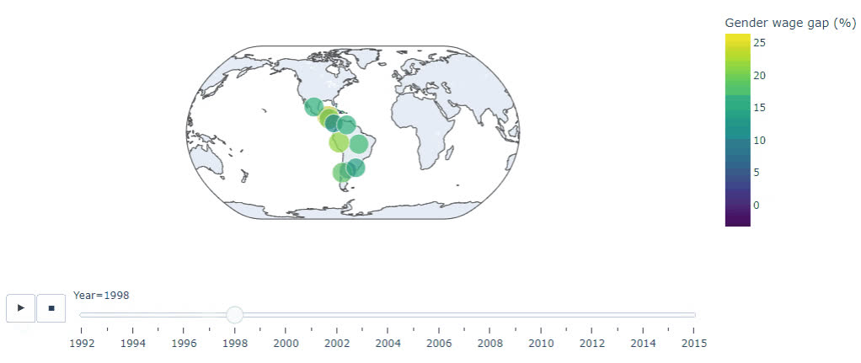
Yıla ve Ülkeye Göre Cinsiyet Maaş Farkı

Slide 4
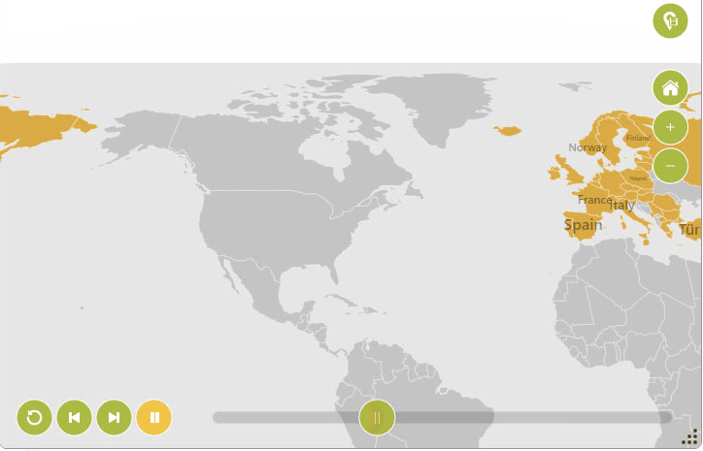

MAAŞ EŞİTSİZLİĞİ MODELİ YAKLAŞIMI
Maaş Eşitsizliği modelinde yer alan ülkeler
1990
-
2017
Women Seat Ratio
Maternal Mortality Ratio
F/M Labor Force Participation
Adolescent Fertility Rate
Year Category

Slide 5
MAAŞ EŞİTSİZLİĞİ MODELİ BAŞARI METRİKLERİ
Model
Train
Test
MSE: 18.56
MSE: 13.24
MSE: 39.61
RMSE: 4.31
RMSE: 3.64
RMSE: 6.29
MAE: 2.90
MAE: 2.50
MAE: 4.49
R-Squared: 0.80
R-Squared: 0.87
R-Squared: 0.46

Slide 6
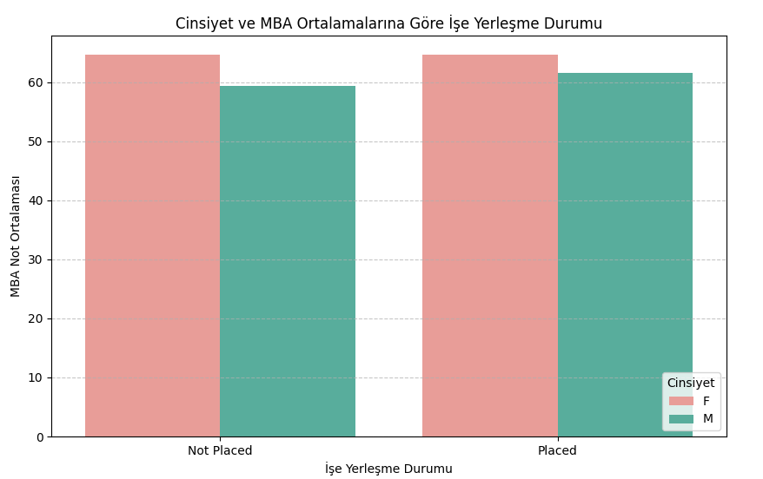

Kadınların, işe yerleşebilmeleri için daha yüksek
not ortalamasına sahip olmaları bekleniyor.

Slide 7
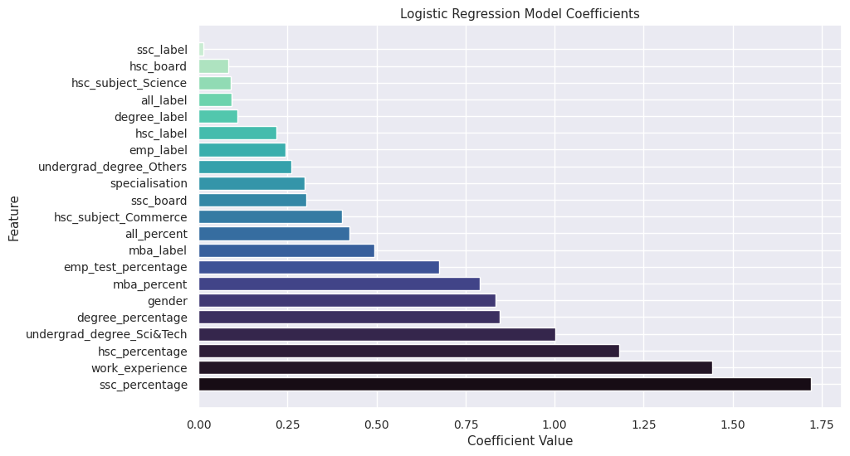
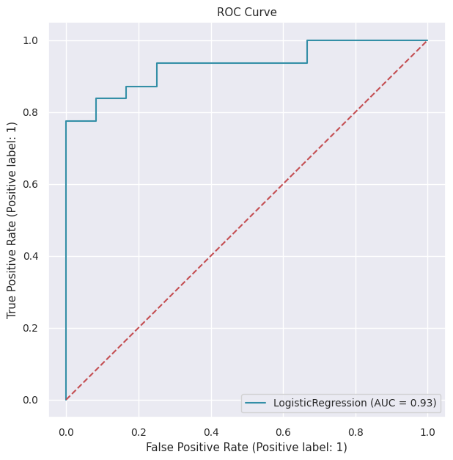
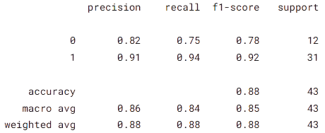

İŞE YERLEŞME MODEL METRİKLERİ
Coefficient Value

Slide 8


Hoşça
kalın...
TEŞEKKÜR
EDERİZ
Kaggle notebook için:
Dilara Çankaya
dilara.cankaya@gmail.com
Eda Çelikeloğlu
edacelikeloglu@gmail.com
Gizem Öge
gizemoge2@gmail.com

